Slide 1


Slide 2
NBIA Update
John Gaset
VP Member Services & Operations
jgaset@nbia.org
321-689-8871

Slide 3
Agenda
About the NBIA
Leadership Team
Direction
Training Institute
Q&A

Slide 4
About the NBIA

Slide 5
About the NBIA
The National Business Incubation Association (NBIA) is the world’s leading organization advancing business incubation and entrepreneurship. Each year, it provides thousands of professionals with information, education, advocacy and networking resources to bring excellence to the process of assisting early-stage companies.
Delivering on the mission for 30 Years
New HQ in Orlando, FL
UCF Research Park area
2000 Members, across 60 Countries
Many of our Members have been with us over 10 years

Slide 6
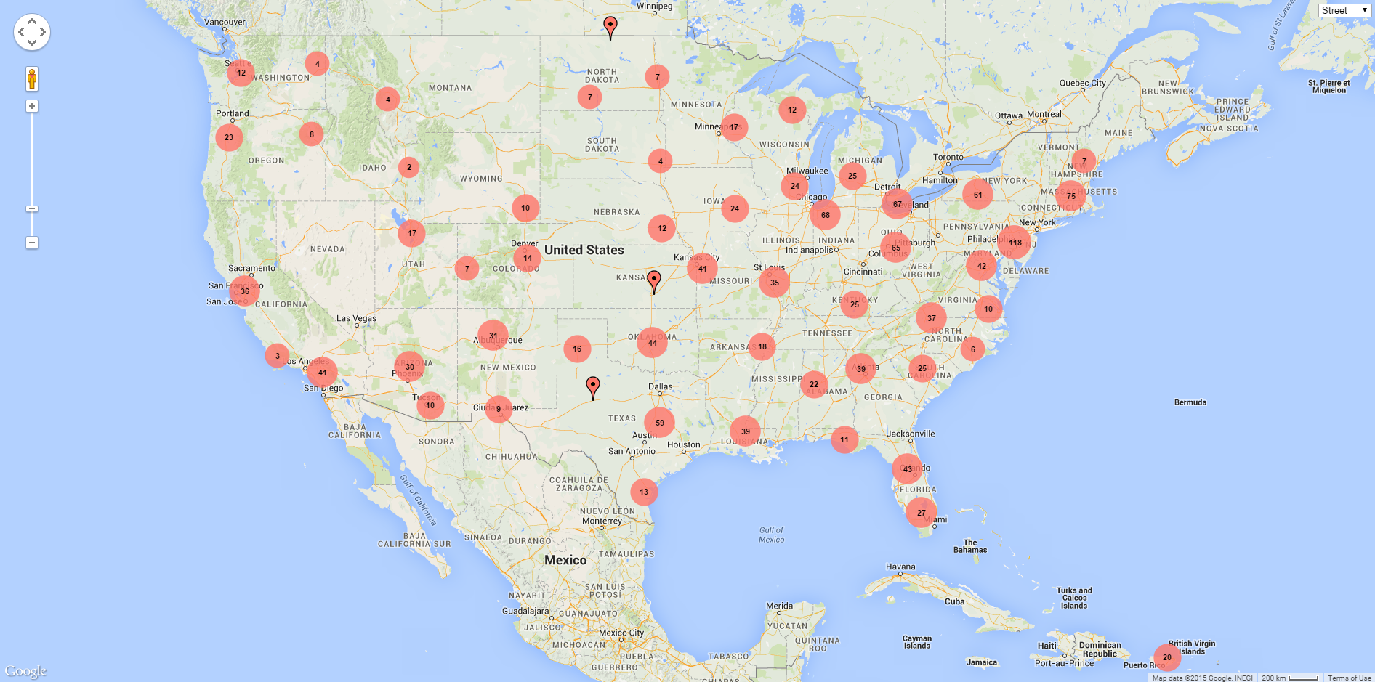
NBIA has Member Organizations in all 50 US States, plus Puerto Rico and the US Virgin Islands

Slide 7
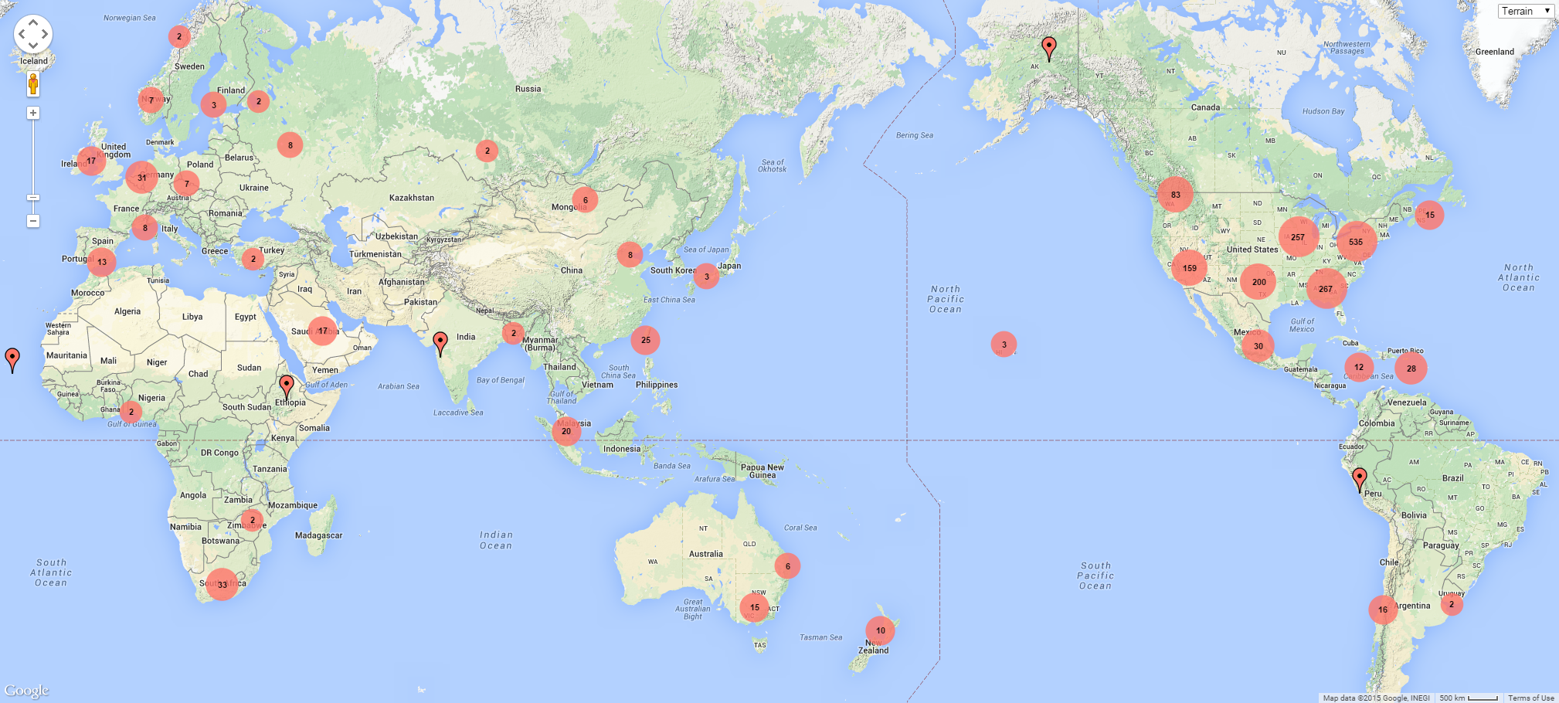
27% of NBIA Members are International
60 Countries
9 Global Regions

Slide 8

A Peek Behind The Pins

Slide 9


Today’s Incubators Are Cool….
Create Business Incubator Västerås, Sweden

Slide 10

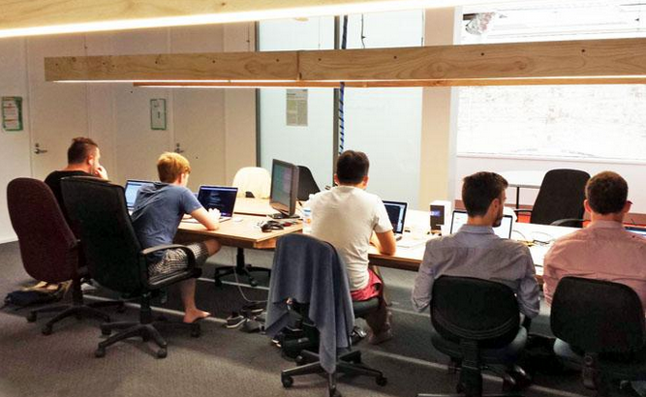
And Many of You are “Going Hybrid”
National Innovation Centre
Accelerator HUB
ATP Innovations
New South Wales Australia

Slide 11
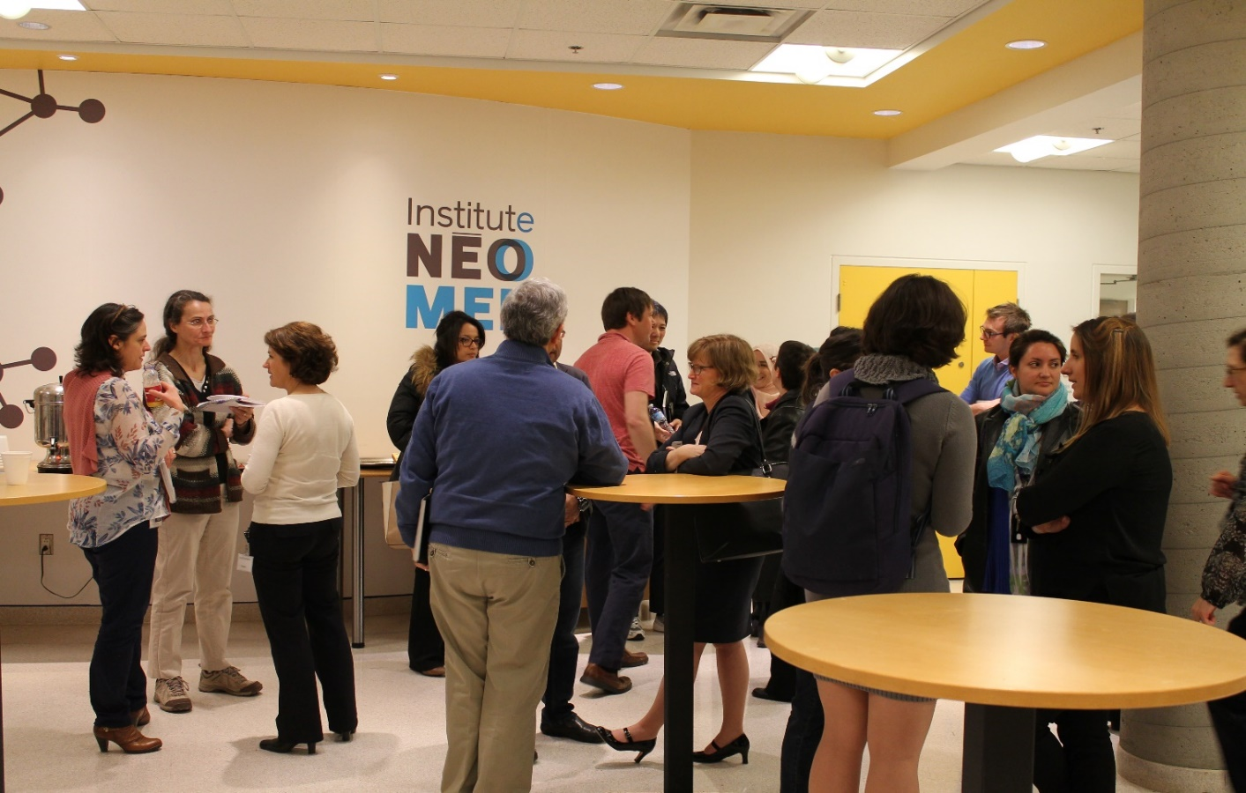
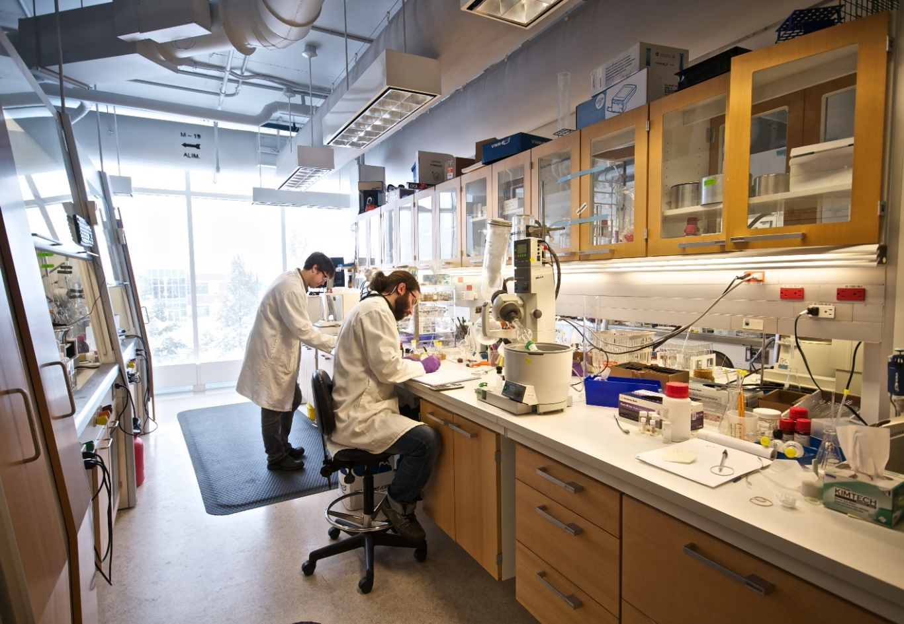
Our Members Are Driving Global Innovation
NEOMED Institute
Montreal, Canada
Notes:
And many of your facilities provide specialized facilities for conducting advanced research, while also providing great spaces and programs for entrepreneurs to collaborate.

Slide 12
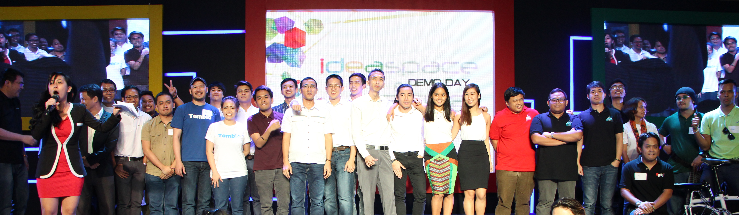
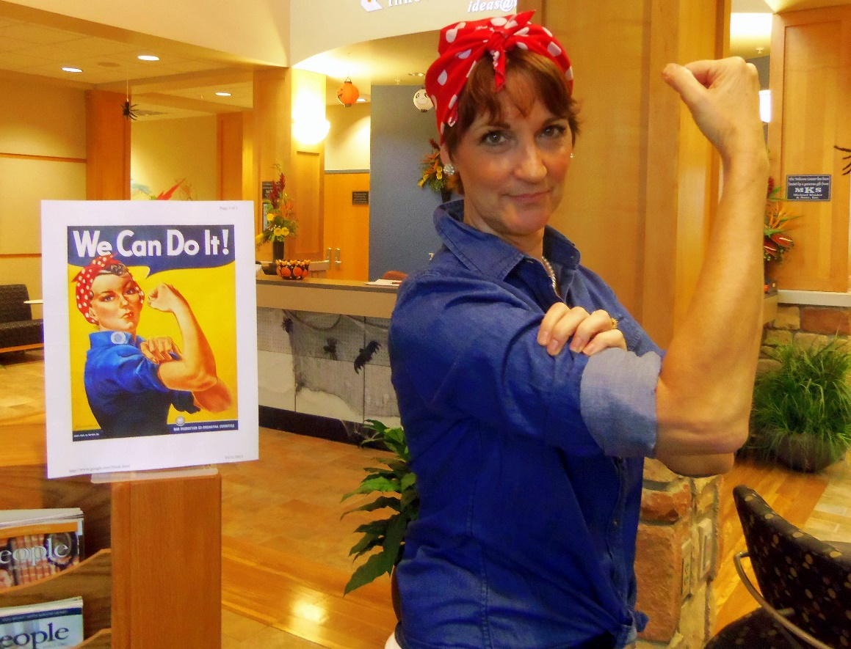
Our Members Serve Diverse Clients
Philippines
NE Indiana Innovation Center

Slide 13
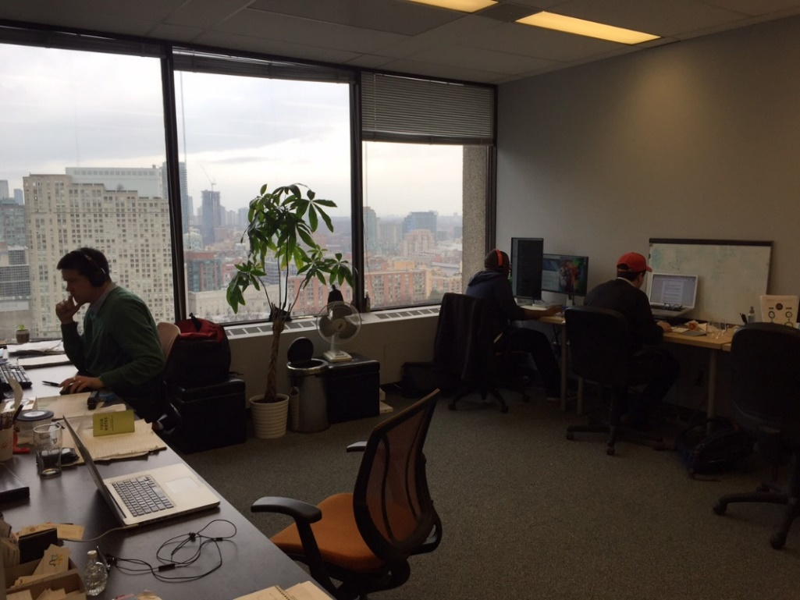
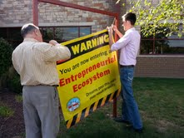
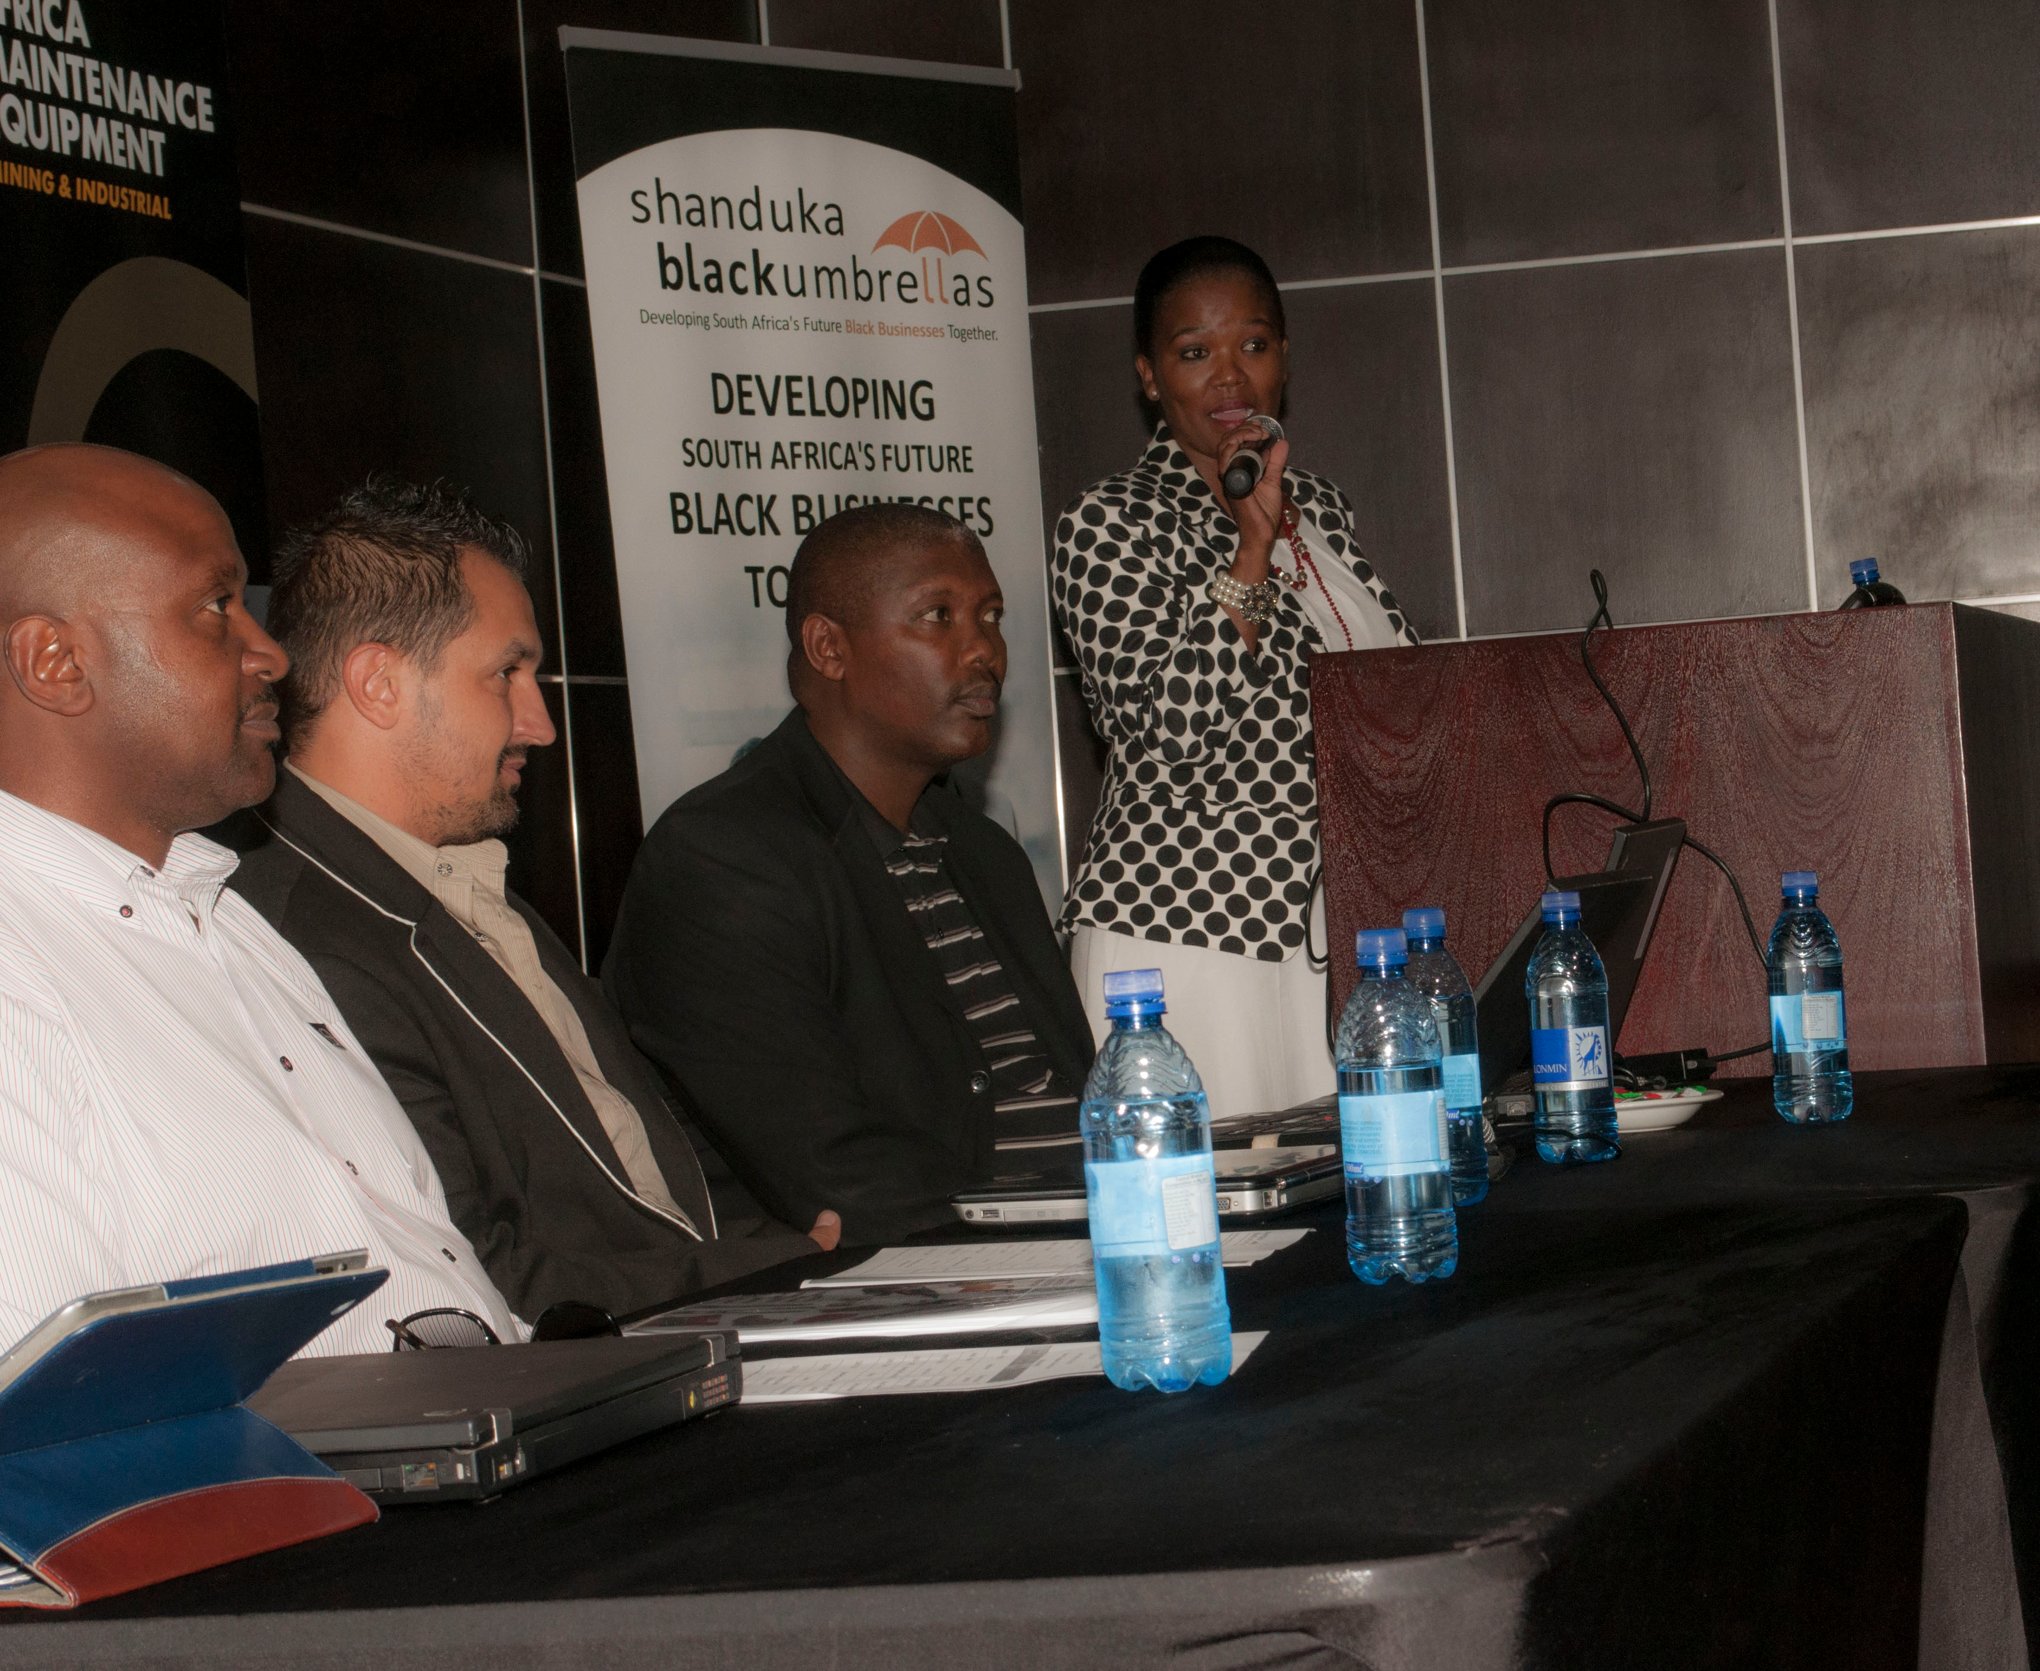
Urban, Suburban, Rural – All Over The World
Toronto Business
Centre
Rural Indiana
Shanduka Black Umbrellas
South Africa

Slide 14
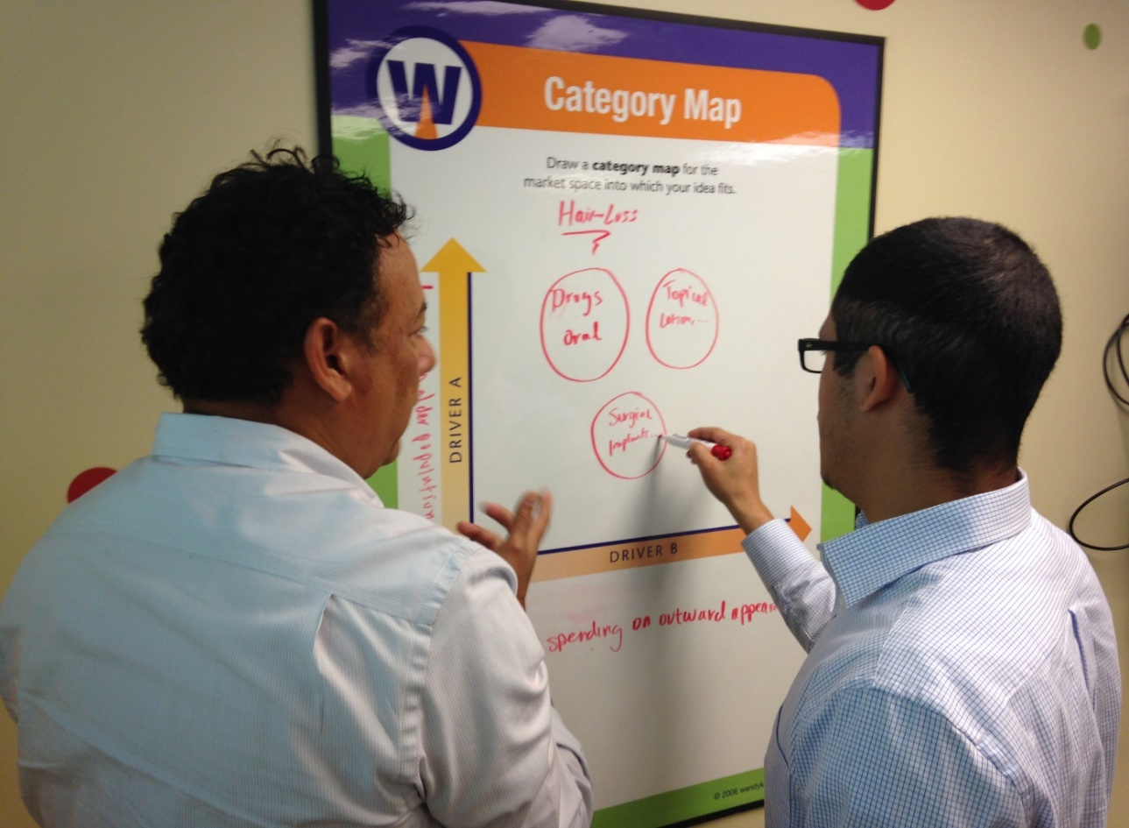
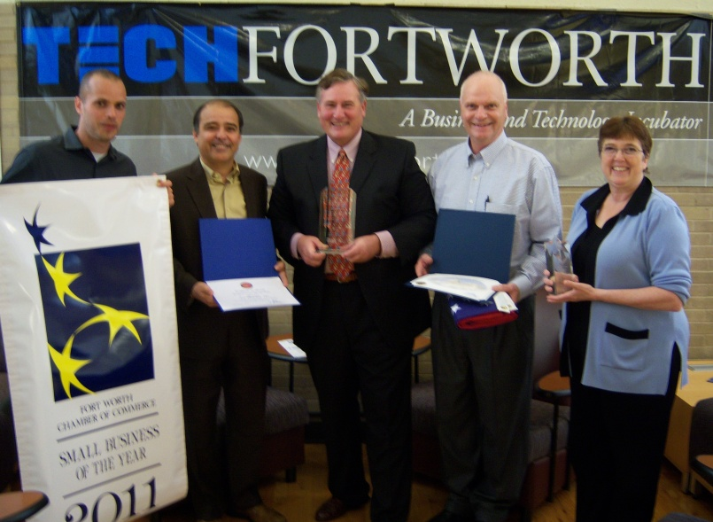
Our Members Are Creating Wealth
ZS Pharma – grew from two founders
to over $1B Market Cap in 5 years
TechFW – Fort Worth, TX
ThinkLab Program

Slide 15
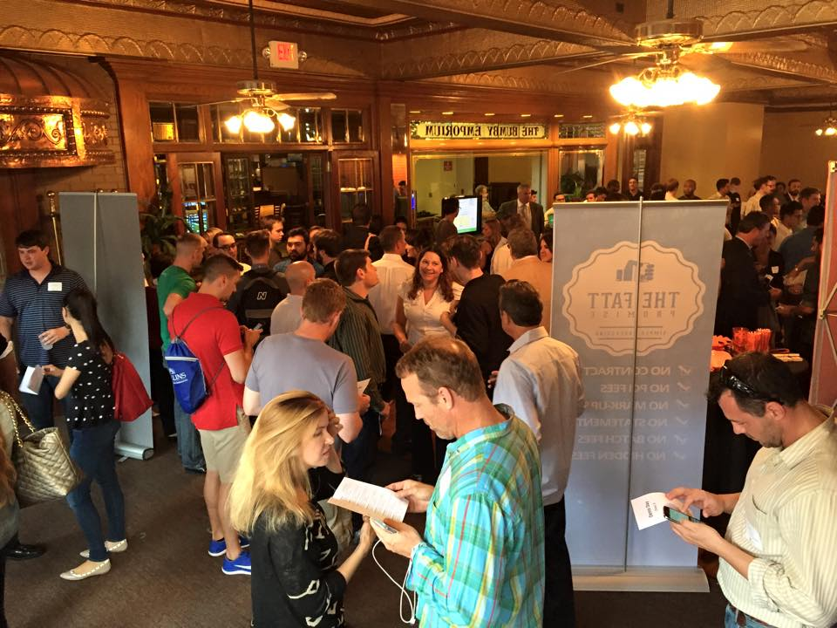
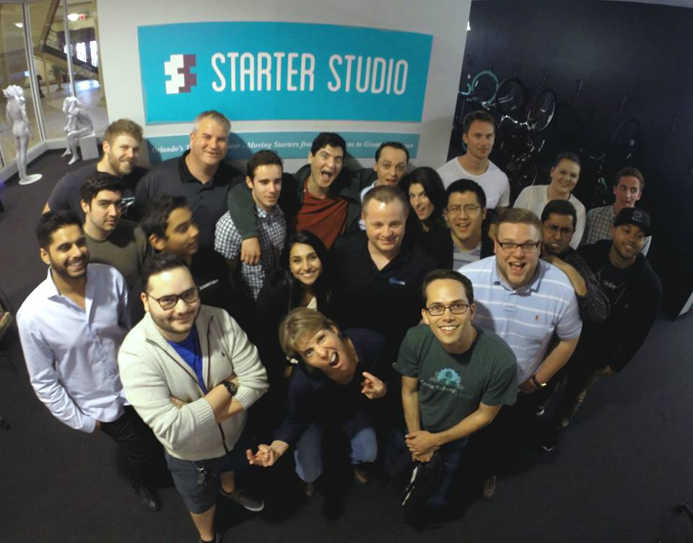
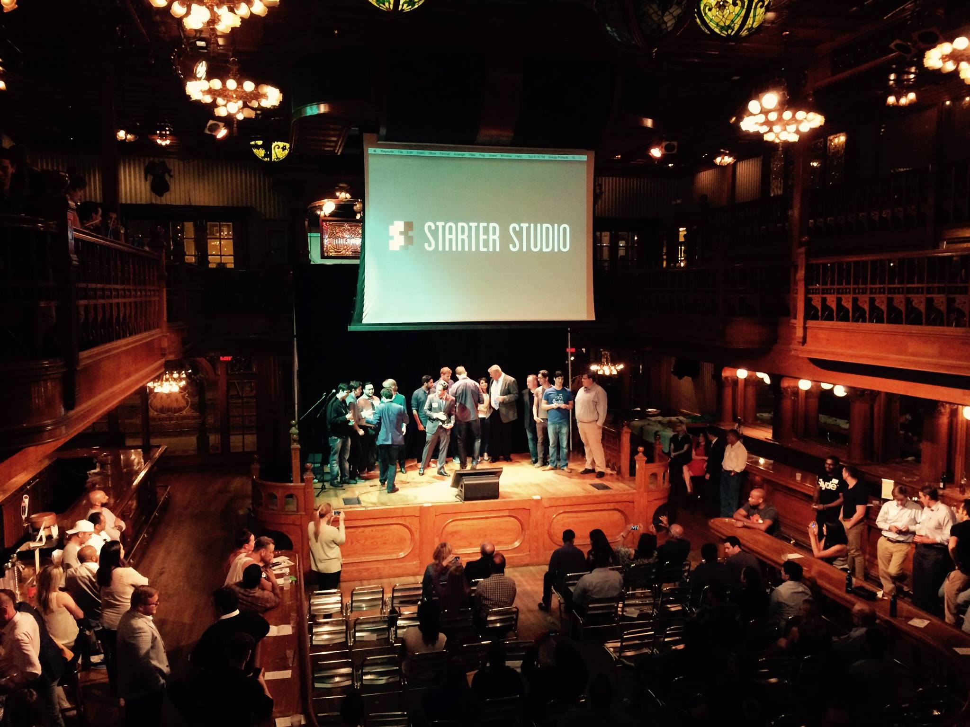
And We Are Having Fun Along the Way…
Starter Studio – Orlando, FL
Demo Day – April 15th, 2015
Notes:
And most importantly, what you are doing is making a difference in the lives of the entrepreneurs in your communities.
I know this first hand, because just a month ago, the latest Cohort in the accelerator I was leading celebrated their growth in our third Demo Day event.

Slide 16
Leadership Team

Slide 17
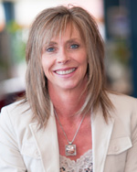
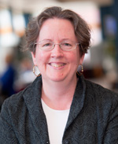

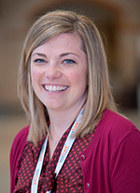
Leadership Team
Kirstie Chadwick
President & CEO
25+ Years Experience
Executive at 5 Start-ups
Incubation/Acceleration
John Gaset
VP Membership & Operations
30+ Years in High-Tech
Sales, Client Services, Product Management
Joy Lee
Director of Marketing & Content
15+ Years Experience
Corporate / Agency
Cheryl Brink
Mary Ann Gulino
Lindsay Schuenke
Molly Mordocco
It’s All About The Staff!

Slide 18
Direction

Slide 19

……..to raise an entrepreneur….
Notes:
A bit about my background for those of you I haven’t yet met. I am an entrepreneur by trade, having worked or founded five venture-backed software startups. I have also walked in the shoes of our members, first at UCF and then as the Executive Director for two accelerators in Florida. I have also sat on the investor side of the table, as I ran a 50-member angel group for two years.
The most important takeaway from my experiences is that it Takes a Village to raise an entrepreneur. The village includes mentors, investors, talented employees, and support from community ecosystem partners that include all of you.

Slide 20





Our members are more than incubators, they include the entire ecosystem…
Incubators, Accelerators
Co-working spaces
Maker Spaces
Education Institutions
Entrepreneurs
Governments
Econ Dev Agencies
Corporate Partners
International Network Partners

Slide 21




Four Strategic Pillars
Curated Curriculums
Global Connectors
Network
Entrepreneur-facing Services
Thought Leadership

Slide 22
Curated Curriculums
Overhaul Certificate Program
Update content – available for 2015 Training Institute in Orlando
Focus on sustainable revenue models, hybrid programs and communities
Expand Soft Landings to Include Accreditation
Develop New Educational Programs – A La Carte
Developing & Maintaining Successful Mentor Networks
Best Practices for Hybrid and Virtual Incubation Models
Building Impactful University Commercialization and Entrepreneurship Programs
Building Successful Biotech/Medtech, Food, and Rural Incubation Programs
Leveraging Technology to Grow Sustainable Entrepreneurship Programs
Sustainable Entrepreneurship Fund and Loan Models for Incubators and Accelerators
Client-focused Boot Camp Curriculums
Lean Startup, Business Model Canvas, MVP Development
Fundamentals of Raising Capital for Tech Startups (Angel, VC, Crowdfunding)
Building Profitable Business Models, Pro Formas and Financial Statements

Slide 23
Global Connectors
Offer popular education programs regionally and online
Migrate ListServ to Online Collaboration Portal
Enables topic-specific collaborations and groups
Enables global search capabilities
Provide Open Source Directory of Documents
Develop Mentor/Talent Recommendation Portal
Private reviews by members, for members
Expand Soft Landings to Connect Client Companies with Qualified Soft Landings program in foreign countries

Slide 24
Entrepreneur-facing Services
In addition to education programs and global mentor networks…
Negotiate Deep Vendor Discounts for Client Companies
Global “World Series” Client Showcase at International Conference
In partnership with state incubation networks and international network partners
Invite corporate partners and investors
Competition tracks – software, cleantech, biotech/health, food, social ventures, non-tech

Slide 25
Thought Leadership
Leverage NBIA membership to regularly collect industry metrics
Develop annual economic impact reports – regional and global
Partner with Tier 1 research institutions to conduct research on incubation industry and entrepreneurial ecosystem best practices
Advocate for our U.S. membership at the Federal level on policies that impact entrepreneurs and small businesses
IP, tax policy (R&D, investor credits), immigration policies (talent), etc.
Work closely with our network partners to create a global voice for entrepreneurs

Slide 26

Vision
Enabling our members to help entrepreneurs create growth businesses regionally, which creates wealth globally
“A rising tide lifts all boats…”
John F. Kennedy

Slide 27
Training Institute

Slide 28

Training Institute
September 8-11, 2015
Rosen Center Hotel, Orlando, FL
New and Revised courses
Full and Half Day sessions
Complete the Incubation Manager Certification Program at a single event
Advanced level courses will cover…
Raising Capital, Pro Formas, Technology Platforms, Niche Markets, Marketing Strategies and more.
Registration opens in 2-weeks
Take advantage of early-bird pricing
Member & Non-Member Pricing

Slide 29
Training Institute Course Schedule
Subject to change – Check NBIA website for final course schedule

Slide 30
Questions!
John Gaset
VP Member Services & Operations
jgaset99@gmail.com
321-6889-8871

